Slide 1
Best Cities Of Ontario based on various parameters
Group-1 Sarah,Khevana,Daniel,Ayokunle
Date : February 14,2023

Slide 2
Which economic region in Ontario has the best opportunities for technical jobs in science?

Slide 3
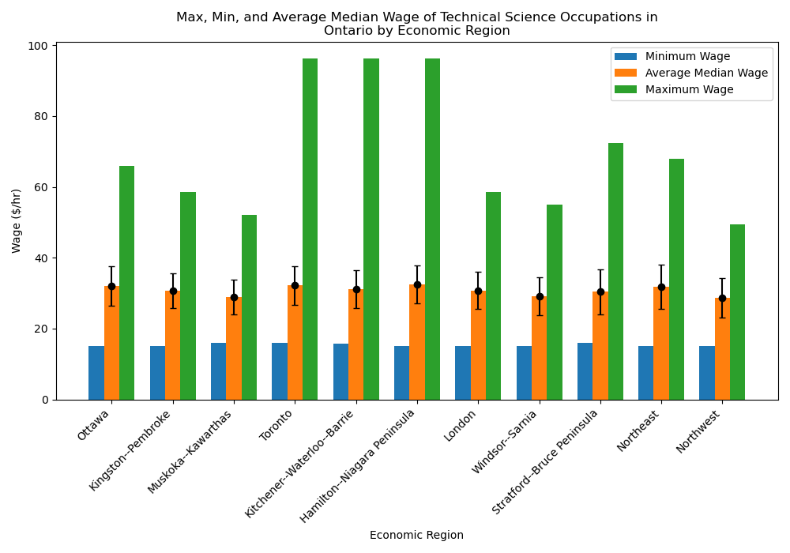
Wage Analysis
The only significant difference between economic regions is absolute maximum wage for technical occupations relating to science in Ontario.
No significant difference between average median, average min, or average max (p-value > 0.4)
Only difference is absolute maximum wage
Highest in Toronto, Kitchener, and Hamilton
May indicate highest wage growth over time in these areas
Recommendation: Start working somewhere with low cost of living, move to Toronto etc. later
Notes:
R-values > 0.4 across the board

Slide 4
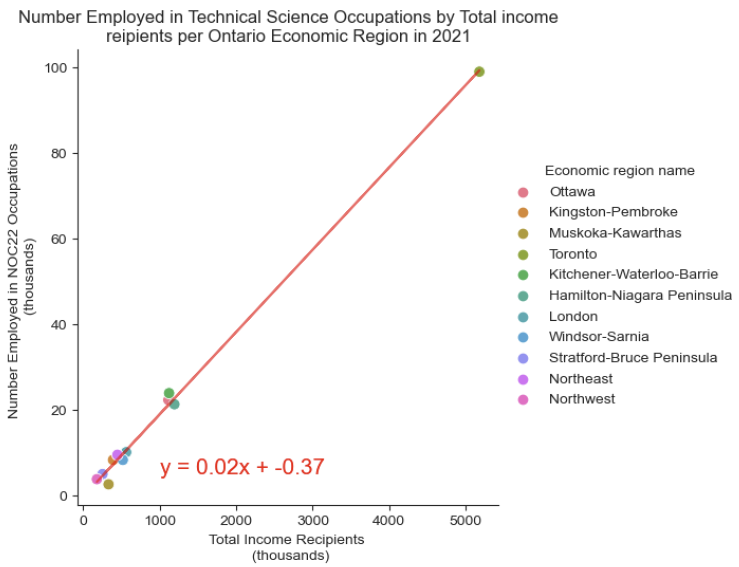
Employment Analysis
Per-capita job opportunities for individuals employed in technical science jobs is similar in all economic regions, but Toronto has the highest number of total opportunities.
Number employed in highlighted occupations correlates to total employment for each economic region
R-value = 0.998
Per-capita opportunities are similar in all economic regions
Toronto has the most job opportunities for technical science jobs
However, Toronto has a higher population so there is likely more competition for job openings
Recommendation: Look in all economic regions in Ontario for jobs, as per-capita opportunities are similar. More are likely available in Toronto however, due to its larger population

Slide 5
Job Opportunities Summary
Job opportunities are similar for individuals employed in technical science jobs in all economic regions in Ontario.
Highest wage growth in Toronto, Kitchener-Waterloo-Barrie, and Hamilton-Niagara Peninsula
Highest maximum wage for technical science jobs but no difference in minimum or average median wage
Similar number of technical science jobs per-capita in all economic regions
Highest total jobs in Toronto
Recommendation: Look in all economic regions in Ontario for jobs. Ideally start working in an area other than Toronto and move to Toronto as you increase in seniority and earning potential

Slide 6
Which economic region in Ontario has the shortest average commute and lowest cost of living?

Slide 7
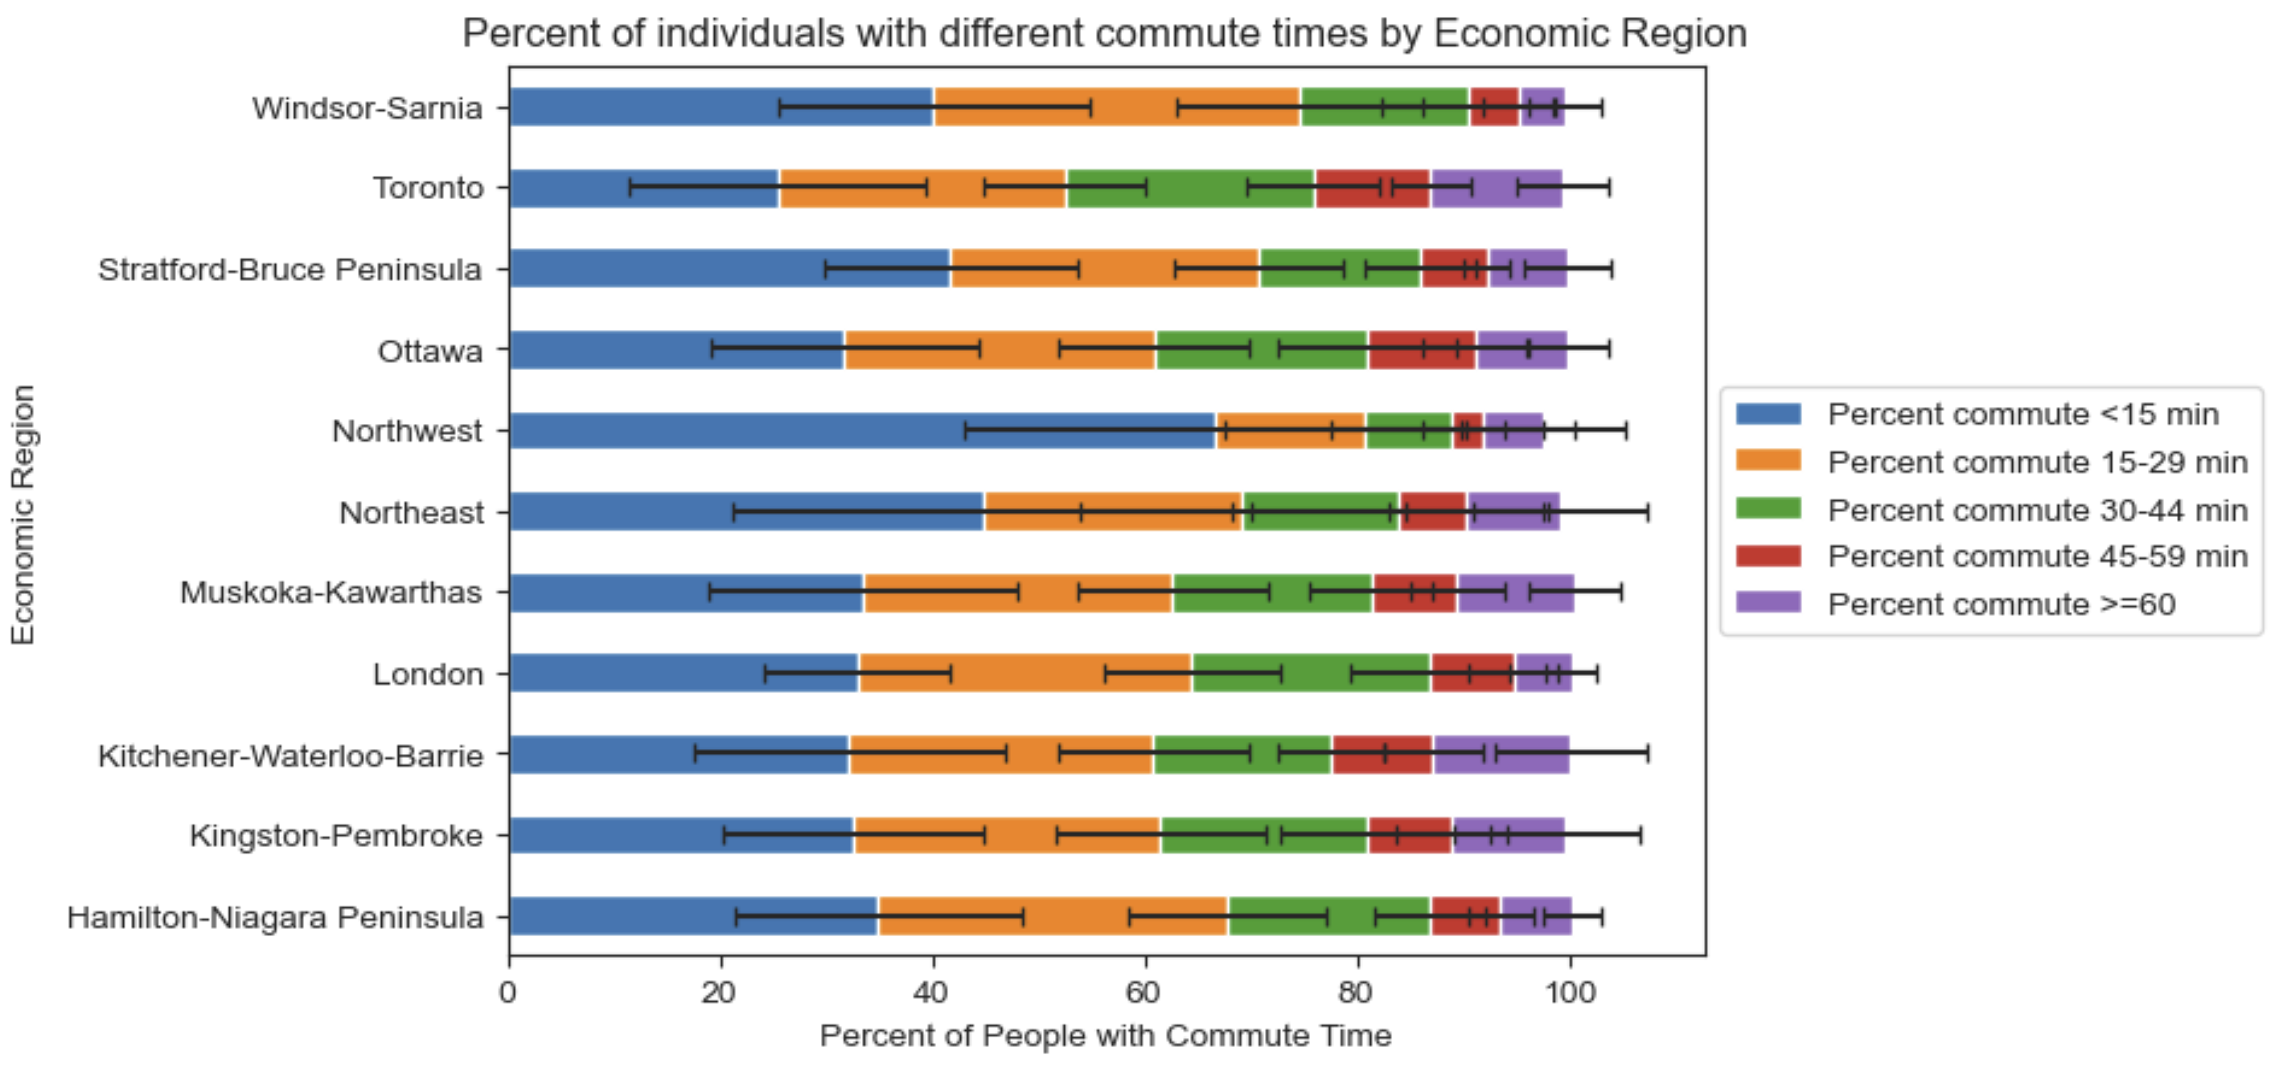
Commute Analysis
The highest percent of people with short commutes is in the Northwest economic region, and the highest percent with long commutes is in Kitchener-Waterloo-Barrie
There are significant differences in the percent of people with each commute time in each economic region
P-value < 0.001 for all bins
Economic regions Northwest, Northeast, and Stratford have the highest percent of individuals with commutes < 15 min
Economic regions Kitchener, Toronto, and Muskoka have the highest percent of individuals with commutes > 60 min
Recommendation: Based on commute alone Northwest, Northeast, and Stratford regions are best to live. Muskoka region has some of the longest commutes without the increasing job opportunities that Toronto boasts, so stay away

Slide 8
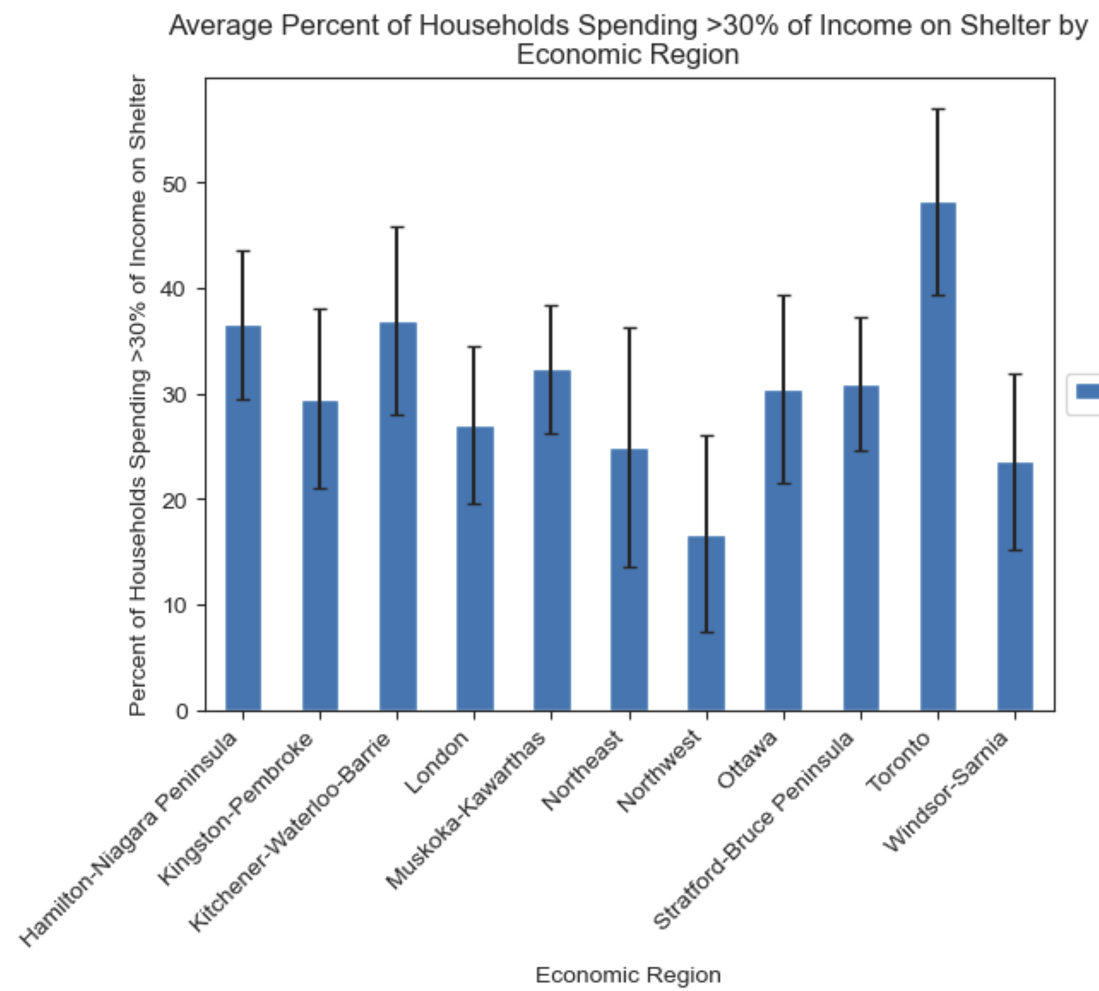
Cost of Living Analysis
The percent of households spending >30% of their income on shelter is highest in Toronto
There are significant differences in the percent of households spending >30% of income on shelter between economic regions
P-value = 2.7x10⁻³⁵
Toronto has the highest percent spending >30% of income on shelter, at 48%
This indicates that Toronto likely has the highest cost of living
Recommendation: Try not to live in Toronto, unless you can get a high wage
Percent spending >30% of income on shelter

Slide 9
Overall Summary
The Northwest economic region is the best with regards to commute and cost of living; Toronto is the worst
The wage and number of technical science jobs per capita in each economic region is similar, so this should only minimally impact choice of location at a junior level
Highest wage growth is in Toronto, Kitchener-Waterloo-Barrie, and Hamilton-Niagara Peninsula, so those with more senior roles may wish to move to these more populated city centers
Commute is longer overall in Toronto and Kitchener, and the cost of living is much higher in Toronto than in the other economic regions
The Northwest economic region has the lowest cost of living and among the shortest commute time
Recommendation: Try not to move to Toronto unless you get a high-paying job opportunity. If you can get a job in the Northwest economic region, you’re golden!

Slide 10
Health & Safety
Which areas/cities are the safest to live in?

Slide 11
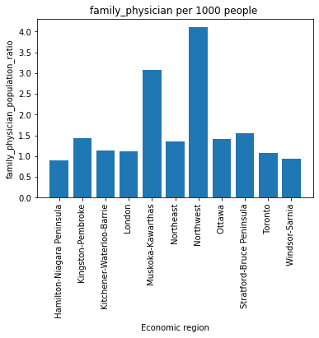
Physicians Availability
As per WHO ideal physician population ration is 1:1000.
calculate physician population ratio using following equation:
([Physicians in an area/population of the area] * 1000)
(https://www.researchgate.net/)
2.77 doctors per 1, 000 people in Canada.

Slide 12
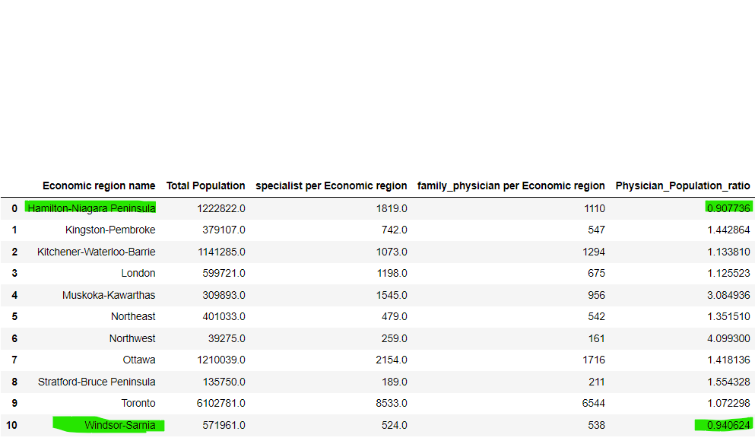
Summary
Analysis:
Visualization indicates Northwest region is better to live in terms of health care as the Physician population ratio is 4.0:1000higher than ideal ratio 1:1000.
However, Hamilton-Niagara Peninsula and Windsor-Sarnia need attention to hire more physician as their ratio is 0.9:1000lower than ideal ration 1:1000.
Best Economic region in terms of physicians availability are Northwest and Muskoka-Kawarthas.

Slide 13
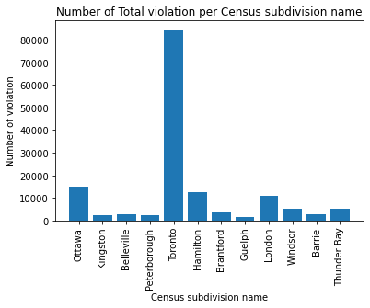
Violation in Ontario
Highest number of violations occurred in Toronto.
Is Population affect the number of violation?

Slide 14
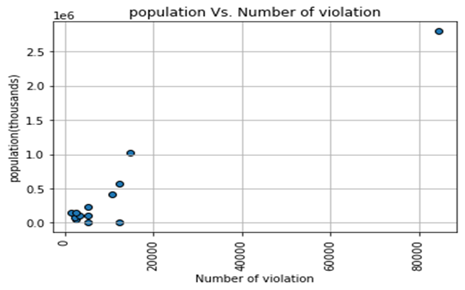
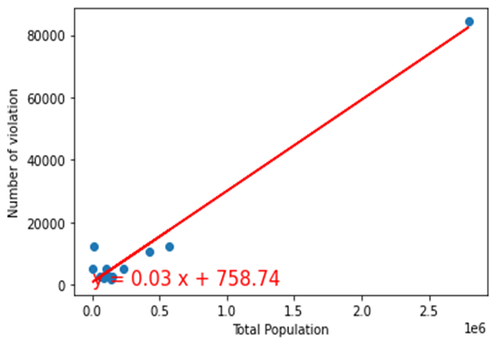
Analysis
There is a positive linear relationship between a city’s population and Number of violation. the r-squared is: 0.9
Highly populated areas are not safe to live compared to less populated area.
High risk city is Toronto with 84360 reported violations.
Low risk city is Guelph with 1570 reported violations.

Slide 15
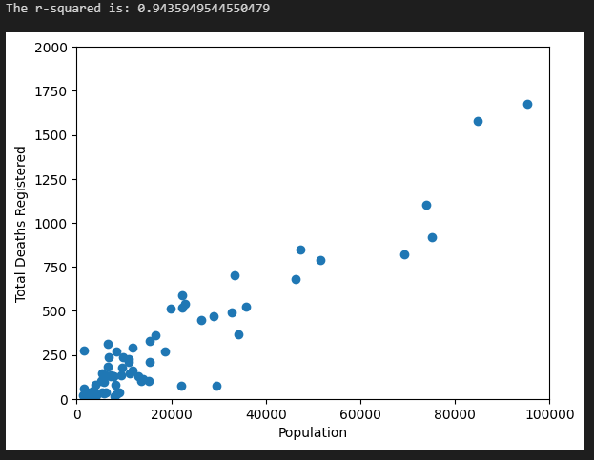
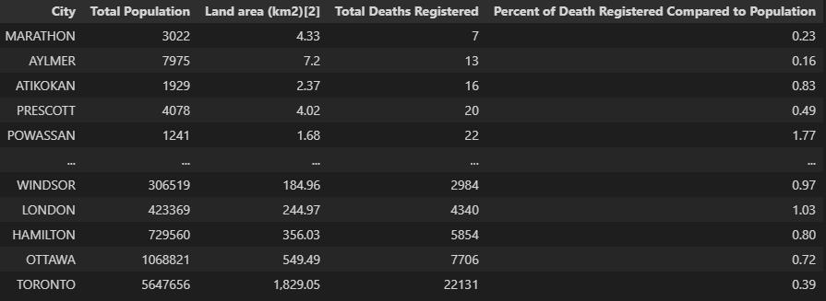
# of Registered Deaths is lower in smaller populated areas
There is a positive linear relationship between a city’s population and registered deaths.
(The correlation between X and Y equals 0.94)
While there can be many factors for cause of death, high populated areas also had the highest cases of death from Covid-19, (Source https://www.publichealthontario.ca/) as well as highest fatal vehicle collisions. (Source Open Data- Toronto Police Service (tps.ca))
As mentioned from the previous slide, the # of total violations was also the highest in Toronto.
Based on the findings, more accidents, violations, and deaths are likely to happen in more populated areas vs less populated areas.

Slide 16
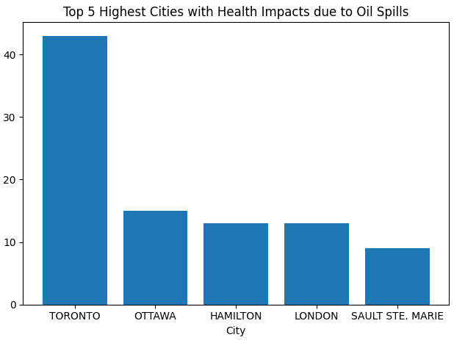
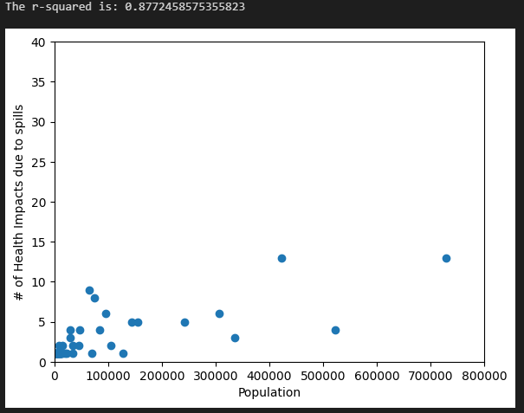
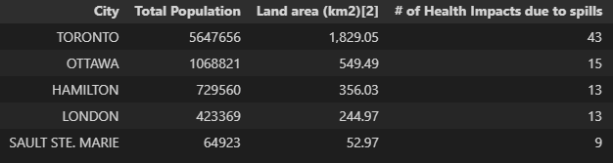
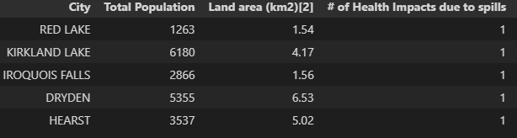
# of Health Impacts due to Oil Spills are lower in smaller populated areas
43
Oil Spills occurred just in Toronto out of 327 occurrences (13%)
0.88
Value for
r-squared
Occurrences of oil spills are more likely to occur in bigger land areas with greater population.
c

Slide 17
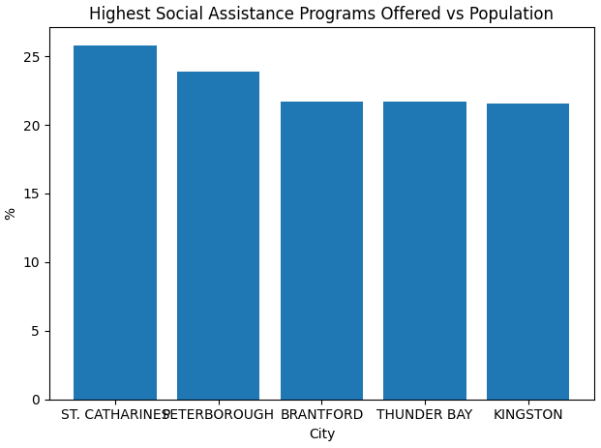
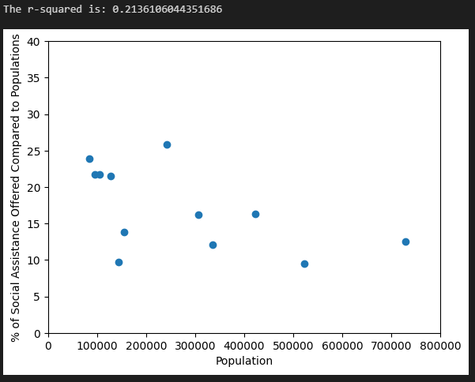
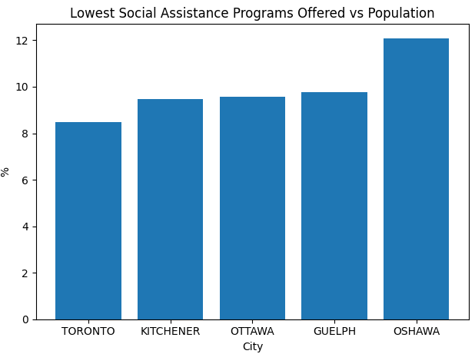
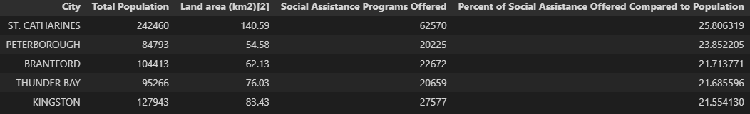
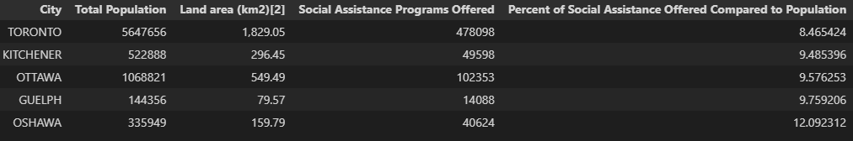
There is a weak relationship between a city’s population vs the % of Social Assistance Programs offered
% of Social Assistance Programs Offered Compared to the City’s Population
While St. Catharines had the highest % of Social Assistance Programs Offered to its population, the % of social assistance programs offered to a city’s population has a weak linear relationship.

Slide 18
Number of Retirement homes & Long Term Homes & Airports in Ontario

Slide 19
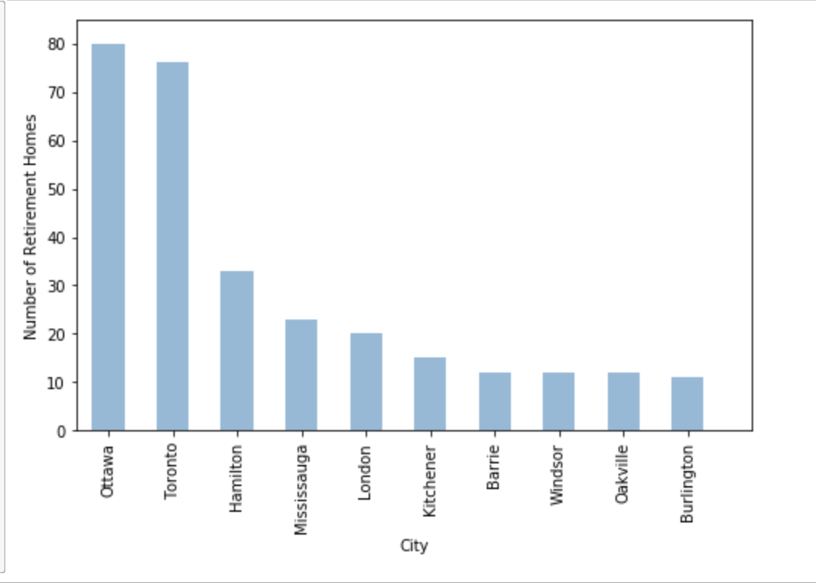
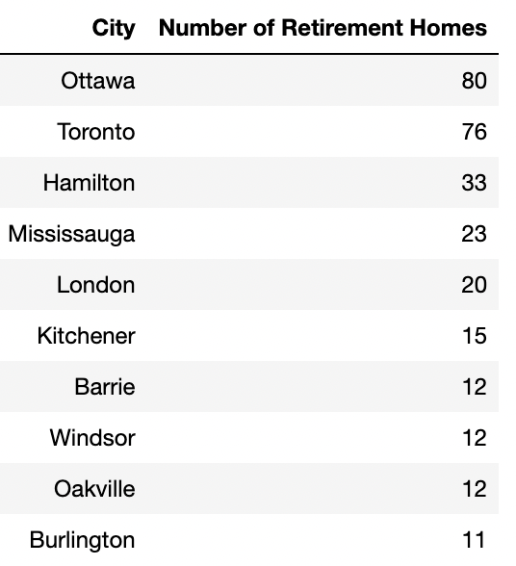

Slide 20
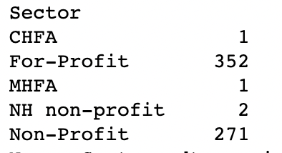
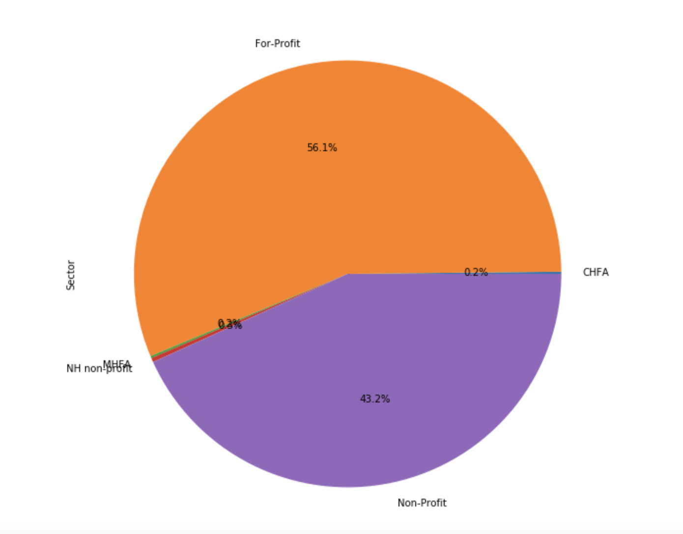
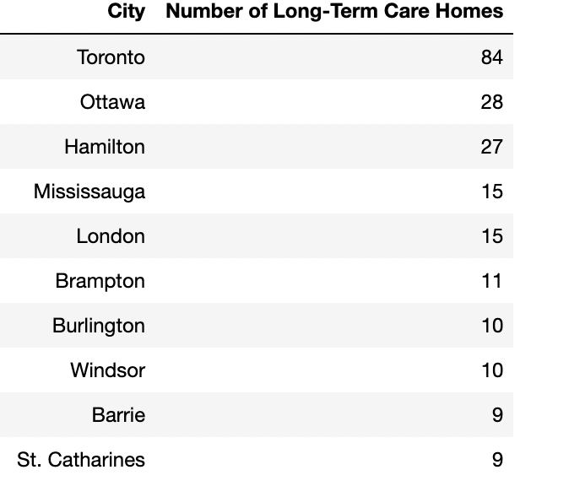
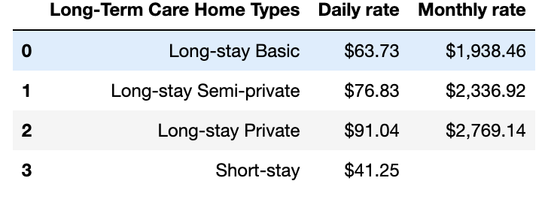
In choosing the best city in Ontario, there are 627 Long-term homes with 56.1% owned by For-profit organizations and 43.2% owned by Non-profit

Slide 21
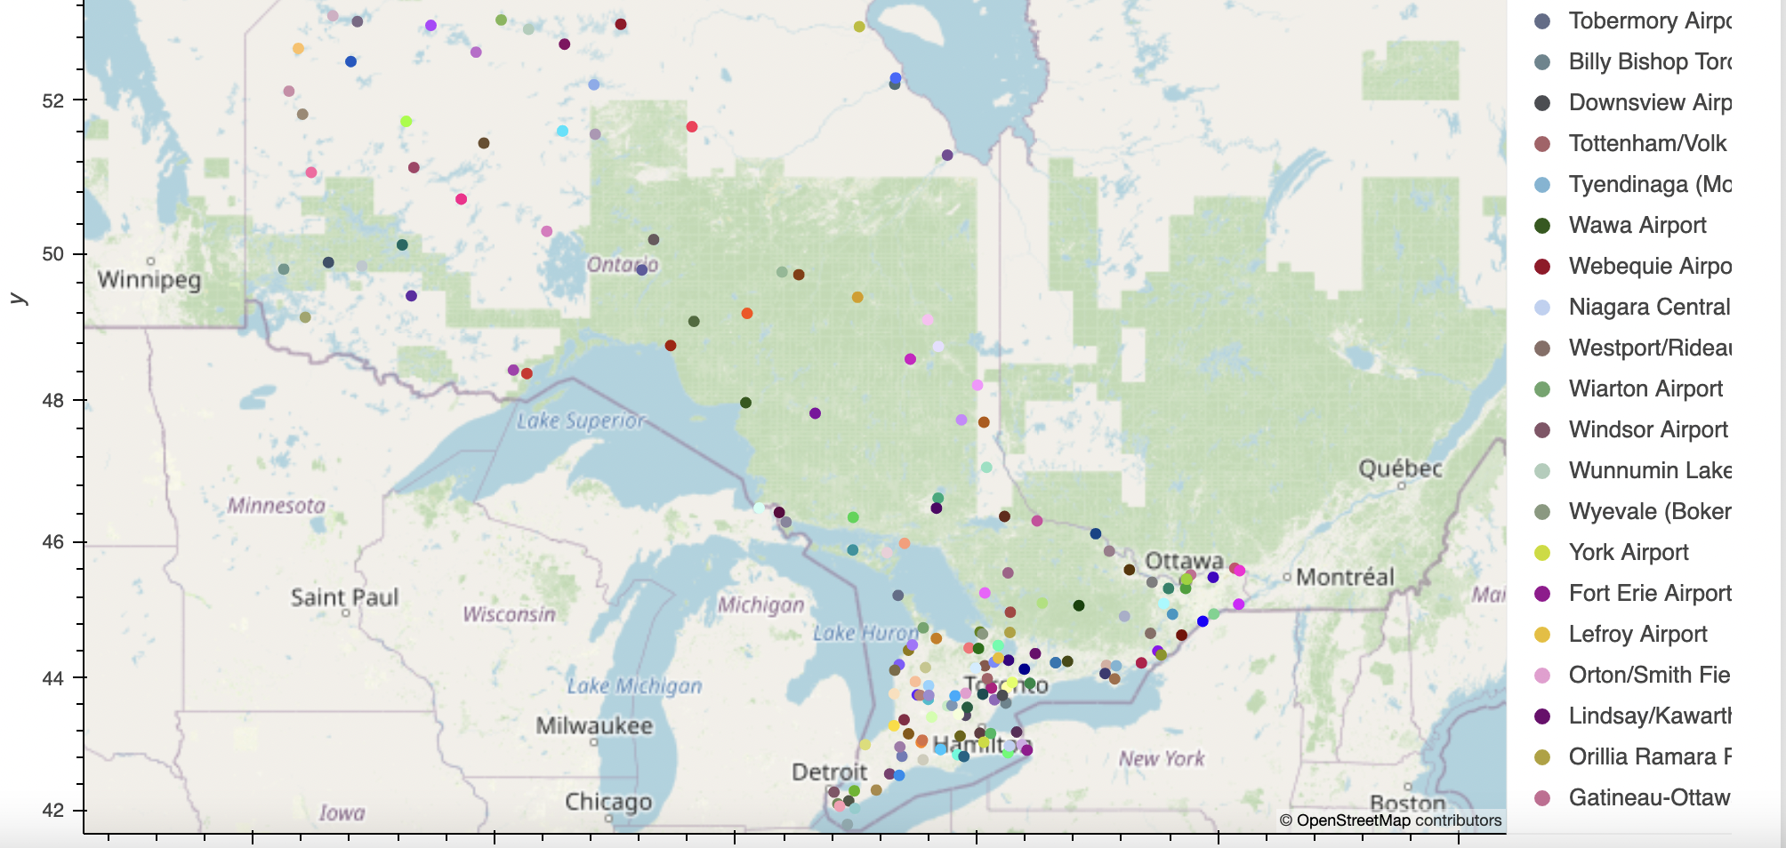
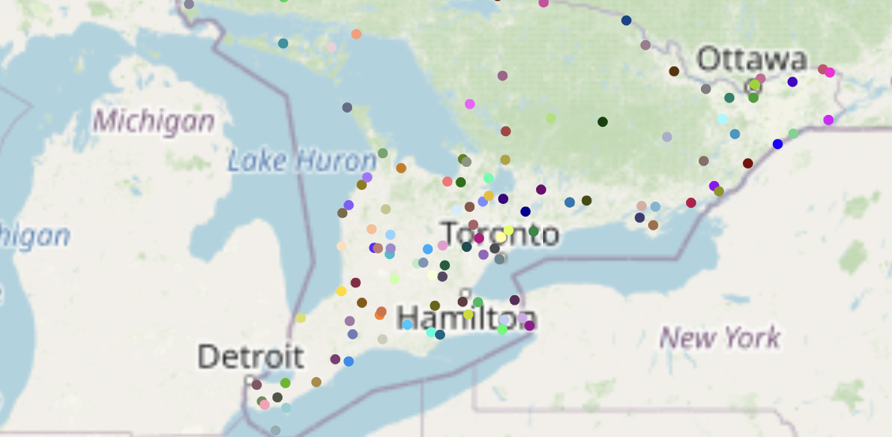
Based on the map, majority of the airports are in the Southern Area of Ontario.
In the Southern Area of Ontario, the top airports are:
Kingston/Norman Rogers Airport (YGK)
Lake Simcoe Regional Airport (YLK)
Niagara District Airport (YCM)
London International Airport (YXU)
Oshawa Executive Airport (YOO)
Peterborough Airport (YPQ)
Region Of Waterloo International Airport (YKF)
Toronto Pearson International Airport (YYZ)
Windsor International Airport (YQG)
Billy Bishop Toronto City Airport (YTZ)

Slide 22


